Slide 1
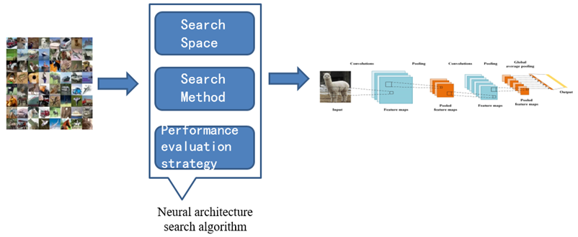
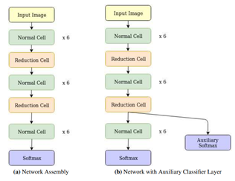
i-DARTS: Improving Differentiable Architecture Search by using graph and few-shot learning
Diallo Mariama
School of Computer Science & Technology
Dalian University of Technology
Dalian, China
e-mail: diallomariama116@gmail.com
Liang Sun
School of Computer Science & Technology
Dalian University of Technology
Dalian, China
e-mail: liangsun@dlut.edu.cn
ABSTRACT
III. EXPERIMENTS AND RESULTS
On the CIFAR-10, ImageNet, and Penn Treebank datasets, Neural Architecture Search algorithms have recently been able to automate the process of architectural design and have frequently achieved state-of-the-art performances. Even though the search time has been lowered from tens of thousands of GPU hours to a few tens of GPU hours, most search algorithms still rely on additional controllers or performance prediction to produce architectural encoding or estimate weights for sampled architectures. The problem of architecture search is not solved because this is done by hand. Using continuous relaxation and gradient descent methods, Differentiable Architecture Search (DARTS) [1] avoids this problem. There are, however, plenty of intriguing methods to make DARTS better. In this paper, we first split the DARTS's supernet into three (03) sub-supernets and applied neural message passing so that each node in the graph has information from other nodes. The three (03) sub-supernets represent the complete search space and utilize gradient descent to discover the optimal subgraph. By adding parameter sharing and transfer learning, our method enhances the final accuracy of one-shot-based DARTS systems consistently. On CIFAR-10, it achieves 98.25% test set accuracy, according to the results.
Keywords— NAS, graph, CIFAR-10, parameter sharing, transfer learning
COMPARISON WITH STATE-OF-THE-ART ALGORITHMS ON CIFAR-10
Method | Data Augmentation | Parameters (M) | Test Error (%) | Search cost (GPU days)
NastNet-A | Cutout | 3.3 | 2.65 | 2000
PNAS | None | 3.2 | 3.41 ± 0.09 | 225
ENAS | Cutout | 4.2 | 2.89 | 0.5
DARTS (1st order) | Cutout | 3.3 | 3.00 ± 0.15 | 1.5
DARTS (2nd order) | Cutout | 3.3 | 2.76 ± 0.14 | 4
i-DARTS (1st order) | Cutout | 3.3 | 1.99 | 1
i-DARTS (2nd order) | Cutout + auto augmentation | 3.3 | 1.75 | 0.44
IV. CONCLUSION
I. INTRODUCTION
The experiments on CIFAR-10 dataset successfully improved the search performance of the original study. Search time on the dataset using DARTS ranged from 10.5 to 72 GPU hours depending on which gradient approximation method was used. The best discovered run obtained
98.25% test set accuracy as compared to 97.24 ± 0.09 % from [1].
Despite the advantages, most architecture search algorithms,
including DARTS, lag in some key areas. Finally, because DARTS
is capable of designing RNNs, it may be applied and studied on
text or time-series datasets.
- The structure of early ANN is relatively simple and the number of layers is small;
However, it's pointed out that these
models are all manually designed through trial
and error;
- While the search cost has been drastically reduced, most algorithms utilize a controller, hyper network, or surrogate network to generate architecture encoding, predict performance, or weights for sampled architectures.
-Despite their success, these controllers and hyper networks themselves might require optimal architectures when deployed on new tasks from different domains. DARTS [1] alleviates this problem.
ACKNOWLEDGEMENT
The authors would like to thank Zhangzhida and Mohameth Faye for useful discussions.
REFERENCES
II. PROPOSED METHOD
[1] H. Liu, K. Simonyan, and Y. Yang, “DARTS: Differentiable architecture search,” 7th Int. Conf. Learn. Represent. ICLR 2019, pp. 1–13, 2019.
[2] Y. Zhao, L. Wang, Y. Tian, R. Fonseca, and T. Guo, “Few-shot Neural Architecture Search,” 2020, [Online]. Available: http://arxiv.org/abs/2006.06863.
[3] H. Tan, C. He, and R. Cheng, “Efficient Evolutionary Neural Architecture Search ( NAS ) by Modular Inheritable Crossover Search ( NAS) by Modular Inheritable Crossover,” no. May, 2020, doi: 10.1007/978-981-15-3425-6.
[4] B. Zoph and Q. V. Le, “Neural architecture search with reinforcement learning,” 5th Int. Conf. Learn. Represent. ICLR 2017 - Conf. Track Proc., pp. 1–16, 2017.
[5] B. Zoph and J. Shlens, “Learning Transferable Architectures for Scalable Image Recognition.”
[6] C. Liu et al., “Progressive Neural Architecture Search.”
[7] H. Pham, M. Y. Guan, B. Zoph, Q. V Le, and J. Dean, “Efficient Neural Architecture Search via Parameter Sharing,” 2018.
[8] T. Wei, C. Wang, Y. Rui, and C. W. Chen, “Network Morphism.”
Neural Message Passing
The defining feature of a GNN is that it uses a form
of neural message passing in which vector messages are
exchanged between nodes in the graph and updated
using neural networks. During each message-passing
iteration in a GNN, the embedding h_{u}^{(k)} corresponding to
each node u e V is updated according to information aggregated from u’s graph neighborhood N(v). This message-passing update can be expressed as in “(1)”.
h_{u}^{(k+1)} = Update^{(k)} (h_{u}^{(k)}, Aggregate ^{(k)}({h_{v}^{(k)},∀v e N(u)}))
= Update^{(k)} (h_{u}^{(k)}, m^{k}_{N(u)}), (1)
Parameter Sharing
Transfer Learning

