Slide 1
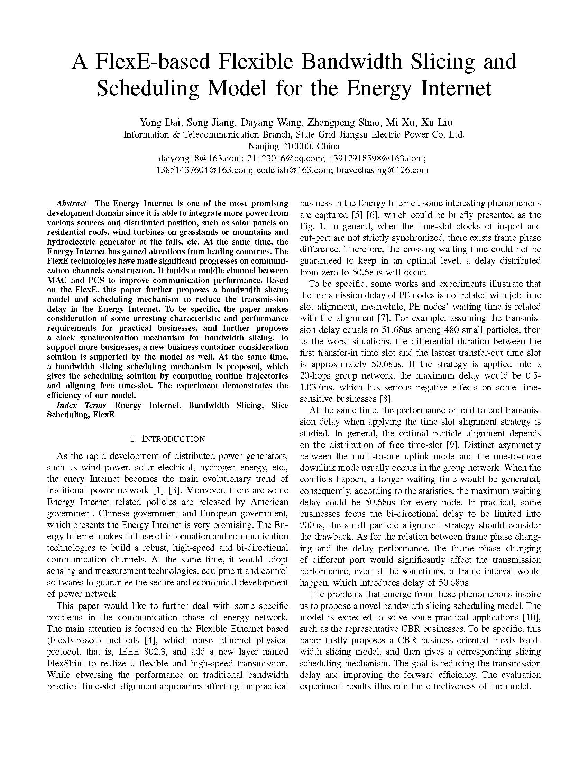
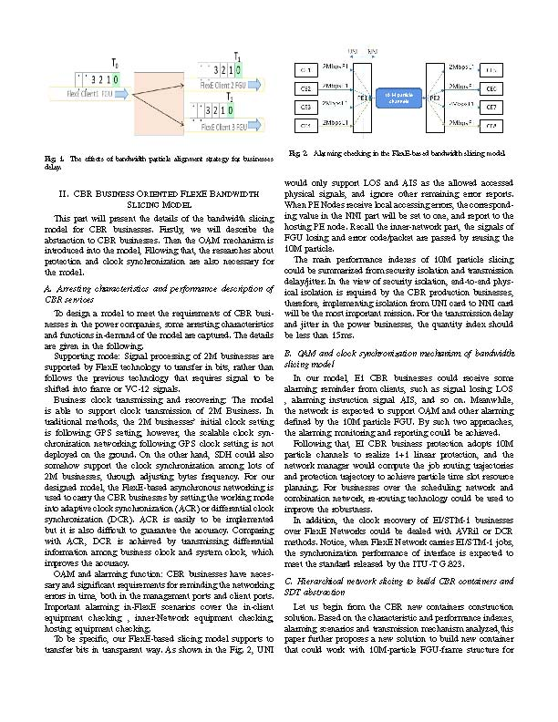
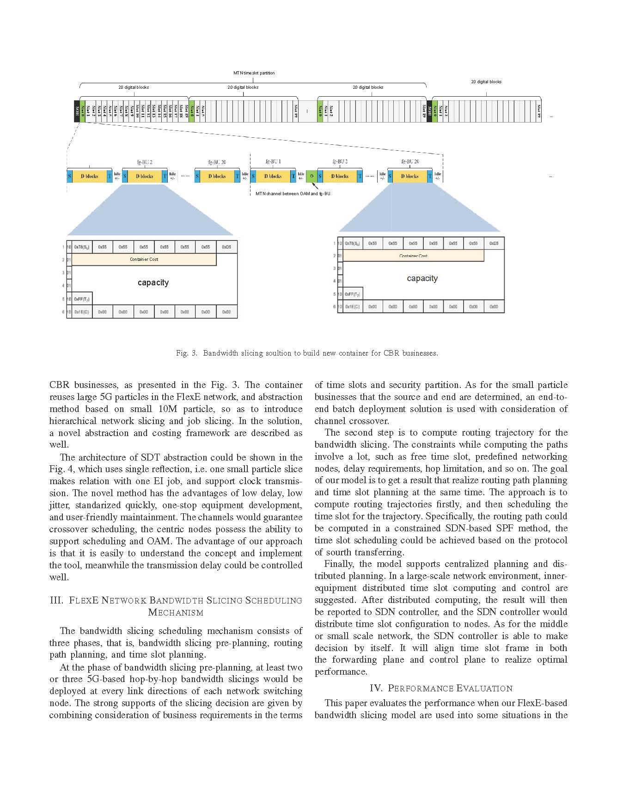
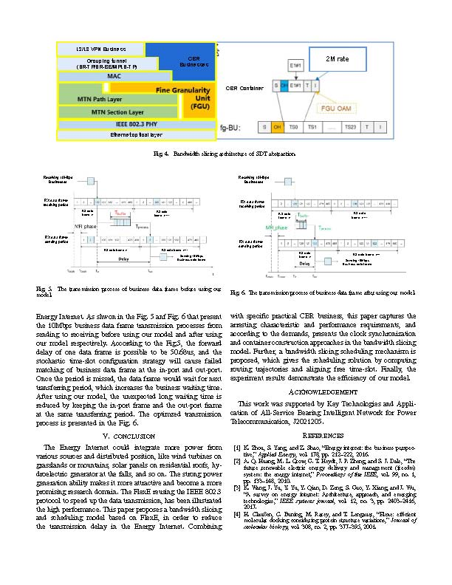
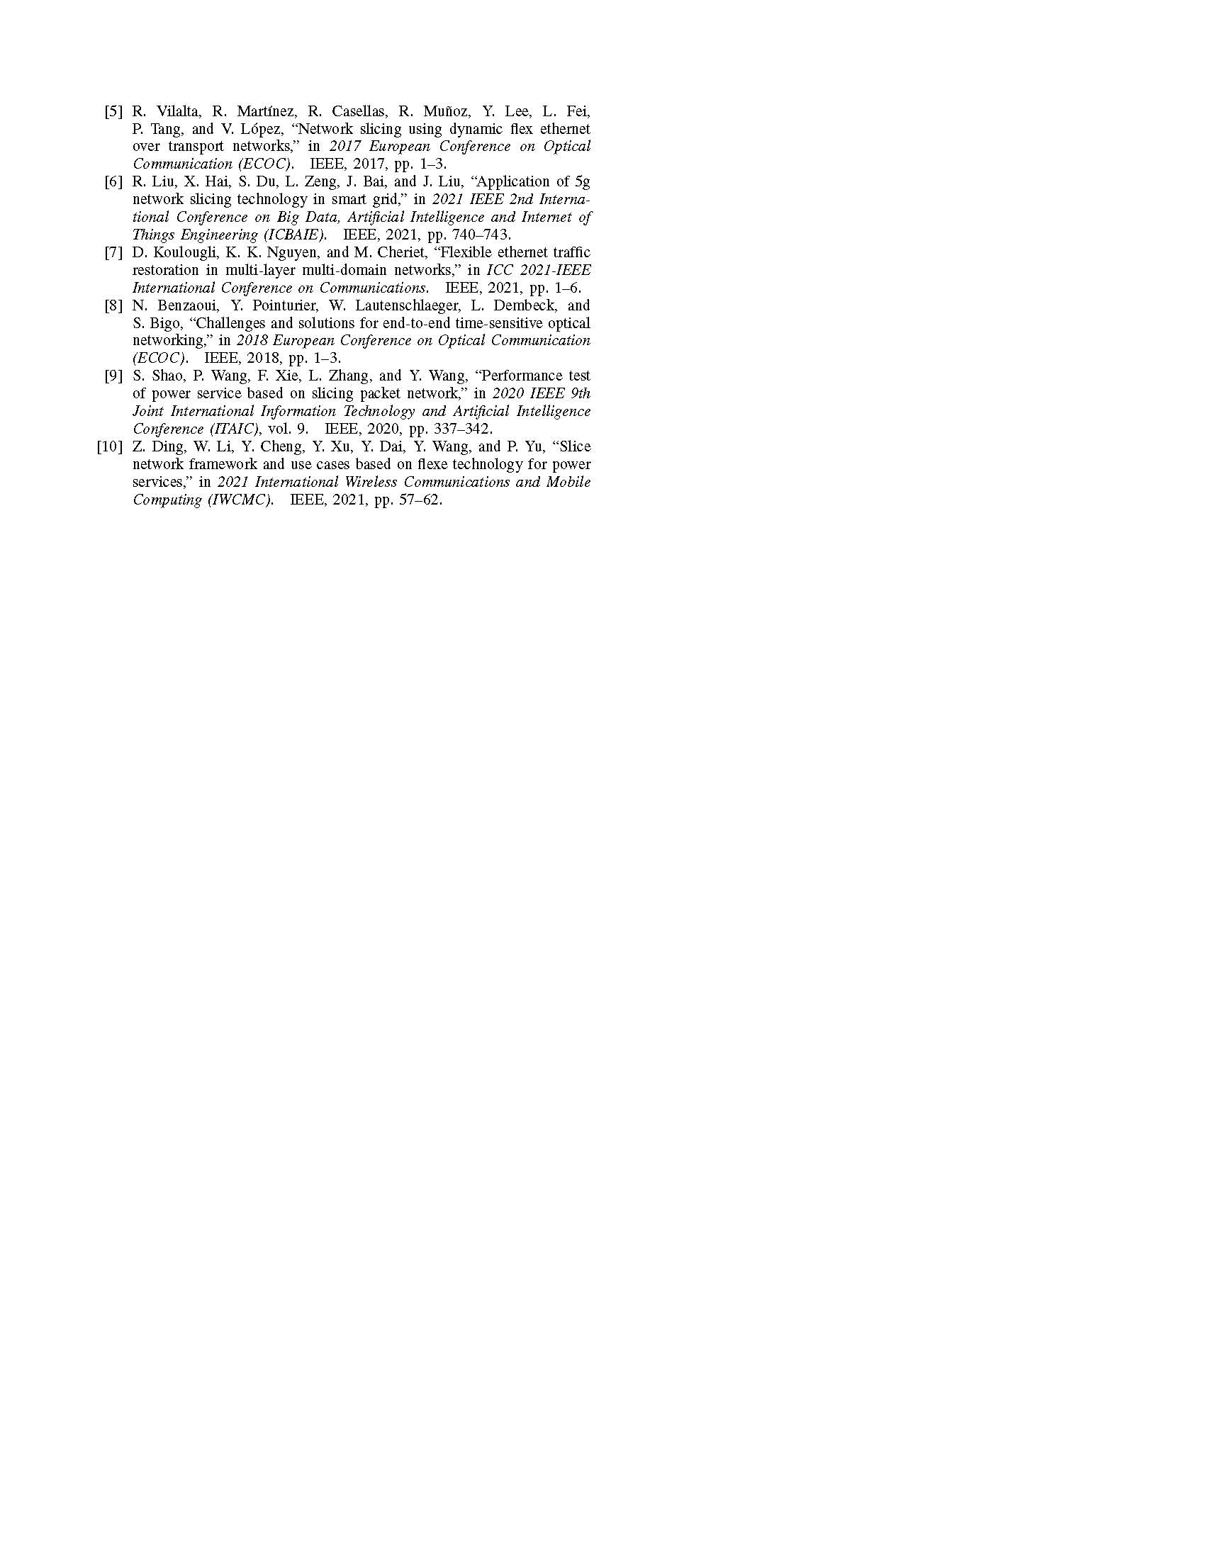
A FlexE-based Flexible Bandwidth Slicing and Scheduling Model for the Energy Internet
Yong Dai, Song Jiang, Dayang Wang, Zhengpeng Shao, Mi Xu, Xu Liu
Information & Telecommunication Branch, State Grid Jiangsu Electric Power Co, Ltd.
Nanjing 210000, China
daiyong18@163.com; 21123016@qq.com; 13912918598@163.com;
13851437604@163.com; codefish@163.com; bravechasing@126.com

