Slide 1
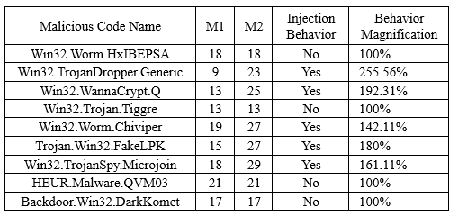
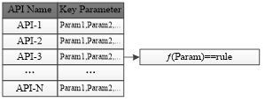
Remote Injected Code Behavior Analysis using Code Refactor
Qian Zhang1, Bo Wu1, Juanjuan Gao¬2, Bin Xue1,3,*
1College of Information and Communication, National University of Defense Technology, Xi'an, China
2Biobank, The First Affiliated Hospital of Xi’an Jiaotong University, Xi’an, China
3School of Computer Science and Technology, Xi’an Jiaotong University, Xi'an, China
cc_2022_cc@163.com, cherry_wb@nudt.edu.cn, juan_gao2018@xjtu.edu.cn, xxbbxl@sina.com
xxbbxl@sina.com
*Corresponding author
Abstract
For remote malicious code injection attacks, the analysis of injected code behavior has always been the difficulty of malicious code dynamic analysis. In this paper, a remote code injection behavior analysis method based on code refactoring was proposed. By analyzing the behavior of remote code injection attack, extracting the injection behavior pattern rules, analyzing the malicious code by using the dynamic binary analysis platform, identifying the remote injection behavior in the execution process, obtaining the remote injected malicious data, then refactoring and executing the injected code, and finally triggering the hidden behavior of injected code, this method improves the integrity of malicious code behavior analysis. A series of malicious code samples were also used for experimental analysis. And the results showed that this method can obtain more comprehensive behavior information for malicious code with remote injection, and effectively improve the integrity of malicious code analysis.
PROPOSAL
The basic idea of remote injected malicious code behavior analysis is to track the execution state of program code, obtain the function call sequence and relevant data flow information when initiating remote injection, match the remote injected mode rules, obtain the original form of the actually executed core malicious code, then carry out assembly and transformation making it an analyzable form that can realize dynamic binary behavior analysis, and ultimately re-execute the code and perform tracking analysis to obtain comprehensive core malicious code behavior information. The overall analysis process is shown in Fig. 3.
Conclusion
The indepth analysis of malicious code remote injection behavior helps to solve the problem that the core functions of malicious code with remote injection behavior cannot be analyzed. Since the behavior of remote injection of malicious code mostly exists as data before execution, the existing methods of integrity analysis based on path coverage can analyze the remote injection behavior of malicious code, but they can’t analyze the behavior contained in the injected code.
Aiming at the above problems, this paper proposes an indepth behavior analysis method of malicious code based on code transformation. During the binary dynamic behavior analysis, this method records the key API functions and parameter calling information of the malicious code, analyzes the remote injection behavior by pattern matching, extracts the code content of remote injection, and finally carries out secondary analysis by means of code reconstruction to extract the complete malicious code behavior. This method achieves more comprehensive behavior information for malicious code and effectively improve the integrity of malicious code analysis.
The analysis method proposed in this paper can be applied to the behavior analysis of malicious code by security companies, which is conducive to the integrity analysis of malicious code and the function realization method of core code. These are of great significance for developing malicious code countermeasures and improving terminal security protection methods.

