Slide 1
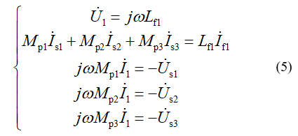
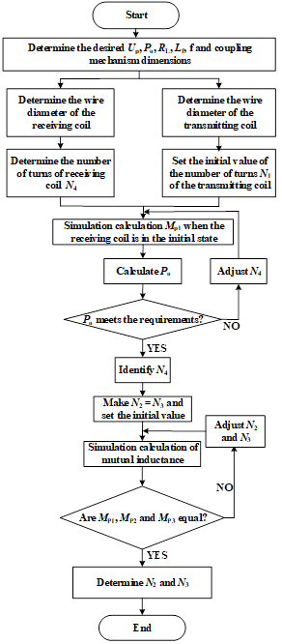
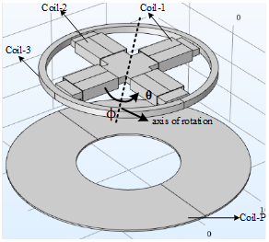
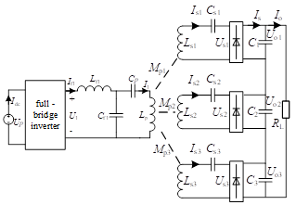
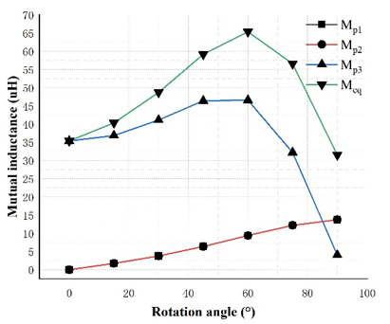
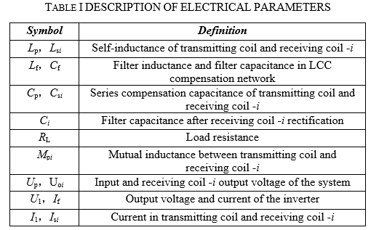
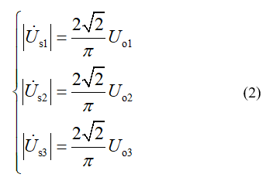
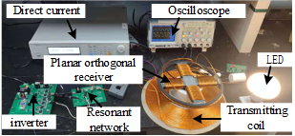
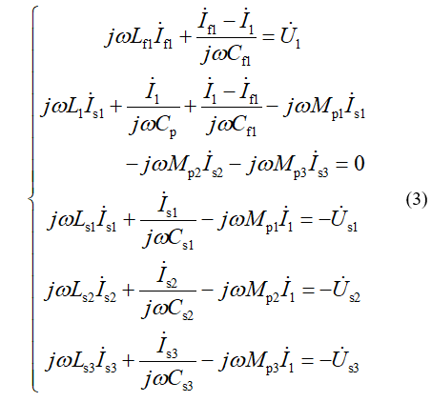
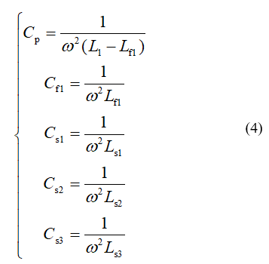
ICAICA 2022
A Planar Orthogonal Receiver for Multi-degree of Freedom Wireless Power Transfer
Hai Hu
State Grid Zhejiang Electric Power Co., Ltd. Ningbo Power Supply Company, China
35989885@qq.com
Wei Xu
State Grid Zhejiang Electric Power Co., Ltd. Ningbo Power Supply Company, China
Xuwei1107@foxmail.com
Yinxing Shen
State Grid Zhejiang Electric Power Co., Ltd. Ningbo Power Supply Company, China
xubanqiu@163.com
Yingjie Li
College of Automation,
Chongqing University
Chongqing, China
1518052283@qq.com
Abstract
In a traditional wireless power transfer (WPT) system, the system output power and efficiency will be reduced sharply when an angular misalignment of the magnetic coupler occurs. To solve this problem, this paper proposes a planar orthogonal receiver for multi-degree of freedom wireless power transfer. The planar orthogonal receiver is composed of two crossed dipole receiving coils and a circular receiving coil, and the three coils are mutually decoupled naturally. Compared with the three-dimensional receiver structure, the proposed planar receiver can effectively save the installation space. To concentrate the power picked up by the three receiving coils, the series current after rectification is selected on the receiving side. On the transmitting side, the LCC compensation network is used because of its constant current output characteristics. On this basis, the system output power is derived. To stabilize the system output power in the case of angular misalignment, the parameters of the magnetic coupler are designed. Finally, the experimental results show that the proposed planar orthogonal receiver is insensitive to angular misalignment.
Parameter Design of The Magnetic Coupler
System Modeling and Analysis
Conclusion
In this paper, a multi-degree-of-freedom WPT system based on planar orthogonal combined coils is proposed. To concentrate the power of the three receiving coils on the same load, a series circuit after rectification is selected at the receiving end; at the transmitter side, an LCC compensation network with constant current characteristics is used. To design a reasonable coupler, the parameter design method of the magnetic coupler is given and multi-degree-of-freedom WPT is realized through experiments. The planar quadrature coil proposed in this paper effectively reduces the installation space, simplifies the control strategy, and reduces the complexity of the system. This system is of great significance in the application of multi-degree-of-freedom wireless power transfer.

